Slide 1
FX Marketplace
➤ Show how existing participants integrations can now send cross currency payments.
➤ Show how Foreign Exchange Providers can sell their services as Mojaloop participants.
Demonstration

Slide 2
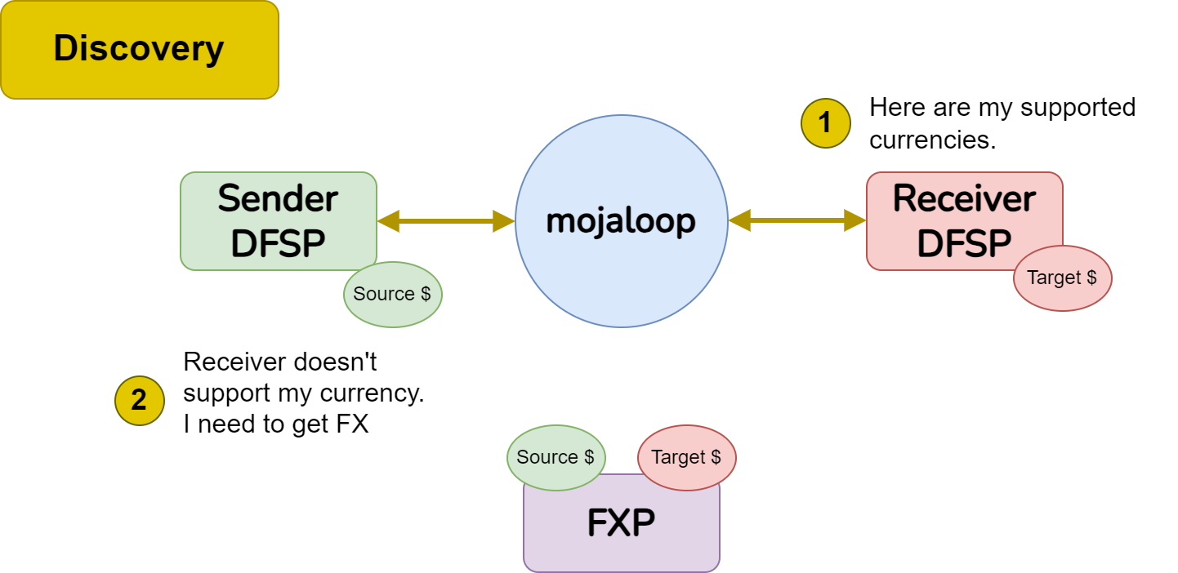
What changed in Discovery?
Notes:
Diagram: https://drive.google.com/file/d/12LcdEHb7i0Y0KqDL8OFa9H0tyjSBplqw/view?usp=sharing

Slide 3
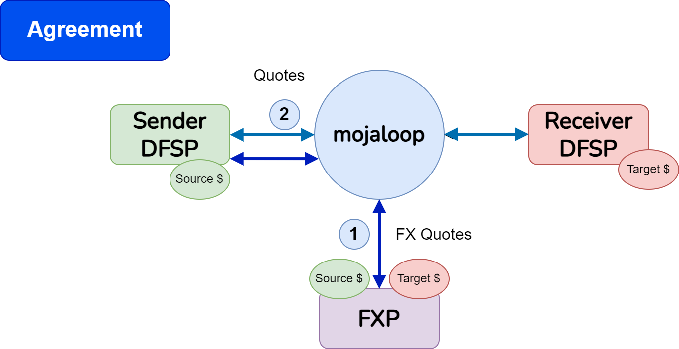
What changed in Agreement?
Notes:
Diagram: https://drive.google.com/file/d/12LcdEHb7i0Y0KqDL8OFa9H0tyjSBplqw/view?usp=sharing

Slide 4
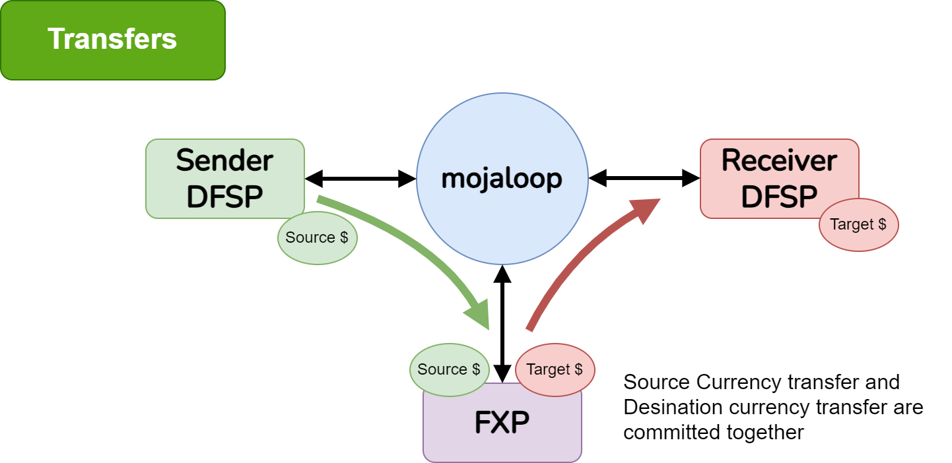
What changed in Transfers?
Notes:
Diagram: https://drive.google.com/file/d/12LcdEHb7i0Y0KqDL8OFa9H0tyjSBplqw/view?usp=sharing

Slide 5
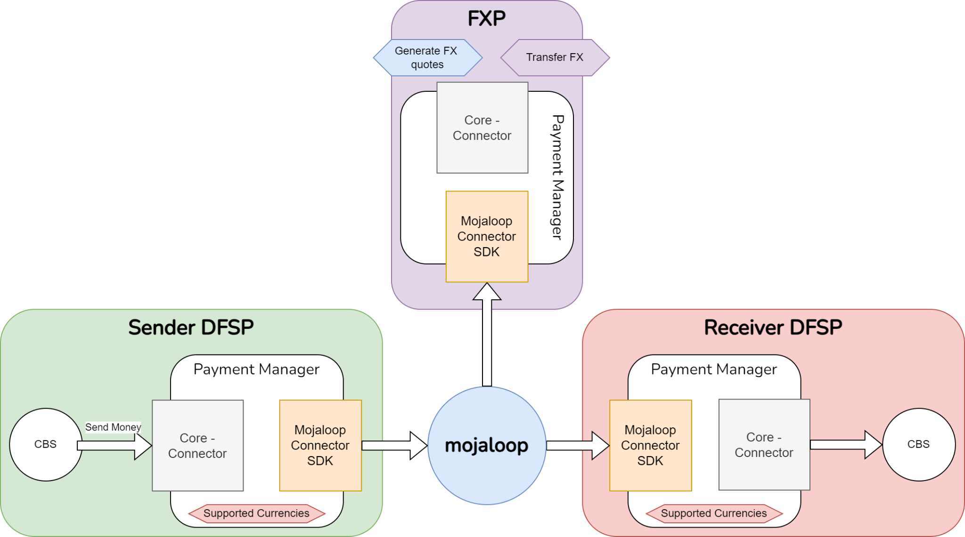
Mojaloop Connector & Payment Manager
Mojaloop Connector has been enhanced to support FX for DFSP integrations and FXP integrations.
New FXP participants can use Payment Manager to build integrations and connect to Mojaloop as Foreign Exchange Providers.
Existing DFSP integrations through configuration can support cross currency payments.

Slide 6
Demonstration

Slide 7
What is next?
Hardening of the functionality
This is already underway with the first component completed
User interface need improvements for FX transfers and the role of the Financial Service Provider
Finance Portal - tracing a transfer
Payment Manager

Slide 8
Thanks to Contributors
Eugen Klymniuk
Kevin Leyow
Paul Baker
Steven Oderayi
Vijay Kumar G

